Slide 1




HEARTIEST CONGRATULATIONS!
A LEVEL CLASS OF 2018!

Slide 2
HIGHLIGHTS
Aditya Birla World Academy offers a total of 12 subjects at the A Level
25 students took the examination
13 out of these 25 students (52%) scored A* and/or A in all their chosen subjects
4 students have scored 90% or above
Class Average : 77%
Highest: 94%
66% of the Grades spread over all subject areas are A* or A

Slide 3
CAMBRIDGE INTERNATIONAL A LEVEL JUNE 2018 RESULTS
GRADE SPREAD OVER ALL 12 SUBJECTS

Slide 4
CAMBRIDGE INTERNATIONAL A LEVEL JUNE 2018 RESULTS
AVERAGE % IN EACH SUBJECT

Slide 5
CAMBRIDGE INTERNATIONAL A LEVEL JUNE 2018 RESULTS
HIGHEST % IN EACH SUBJECT
SUBJECT | PERCENTAGE
ENGLISH | 75%
MATH | 98%
PHYSICS | 92%
CHEMISTRY | 93%
BIOLOGY | 92%
ACCOUNTING | 94%
ECONOMICS | 91%
BUSINESS | 93%
PSYCHOLOGY | 75%
INFORMATION TECHNOLOGY | 79%
COMPUTER SCIENCE | 91%
ART AND DESIGN | 62%

Slide 6
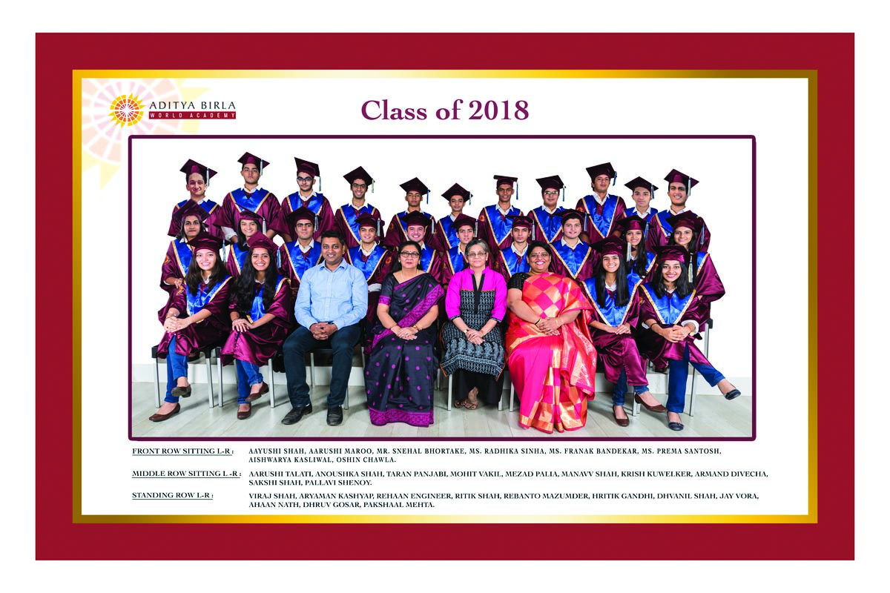
WE ARE PROUD OF EACH ONE OF YOU

Slide 7


SO GO OUT THERE AND LIVE YOUR DREAMS
LIVE THE LIFE THAT YOU HAVE IMAGINED!
WITH LOVE TO ALL OUR STUDENTS.......

