Slide 1



Slide 2
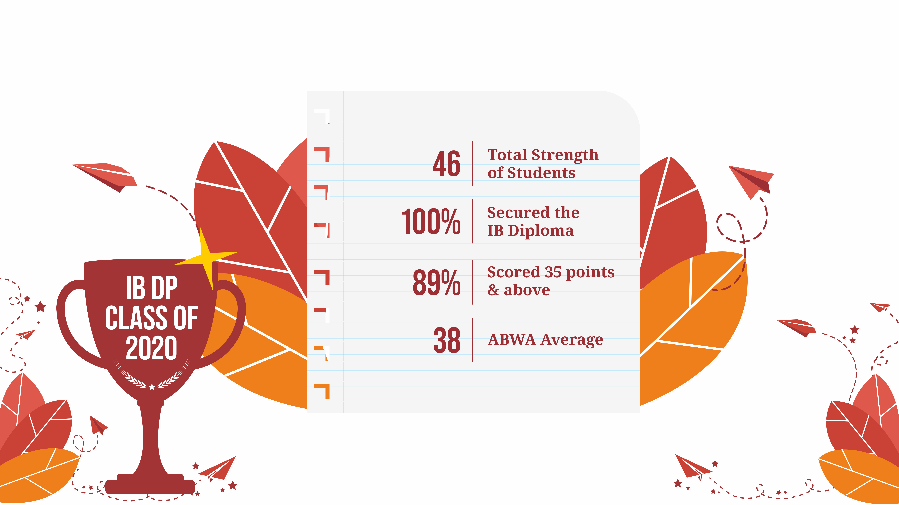

Slide 3


DP SCORE DISTRIBUTION
89.13% scores
are above 35

Slide 4
GRADE DISTRIBUTION
75% grades
are 7s & 6s

Slide 5

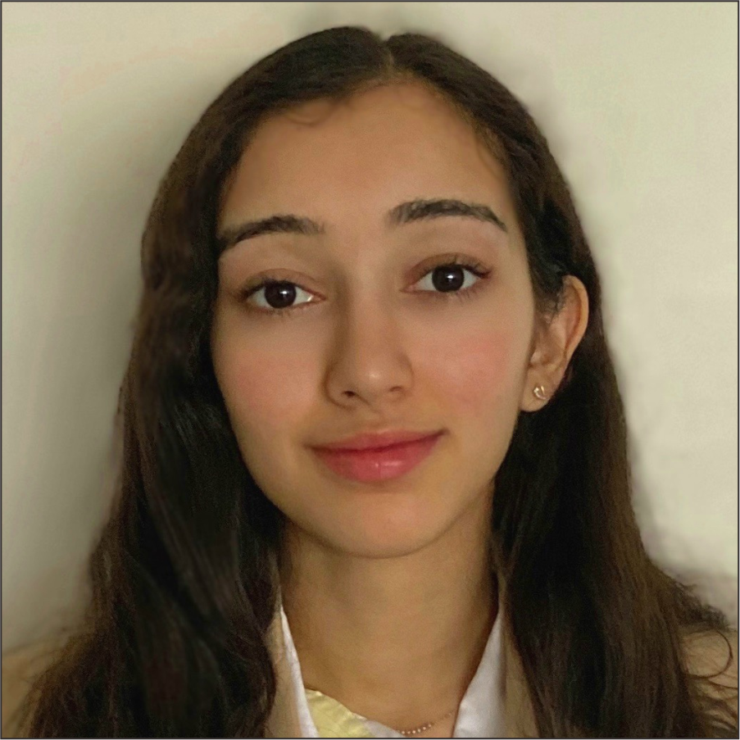
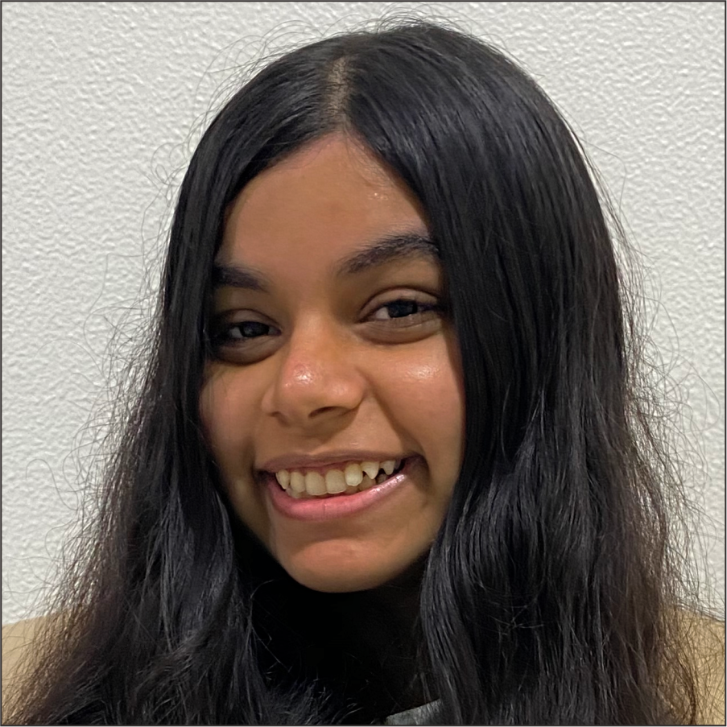
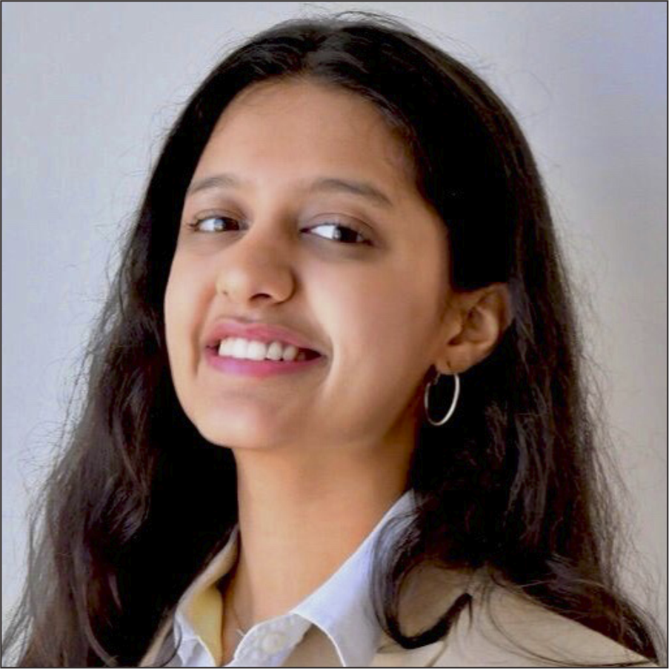
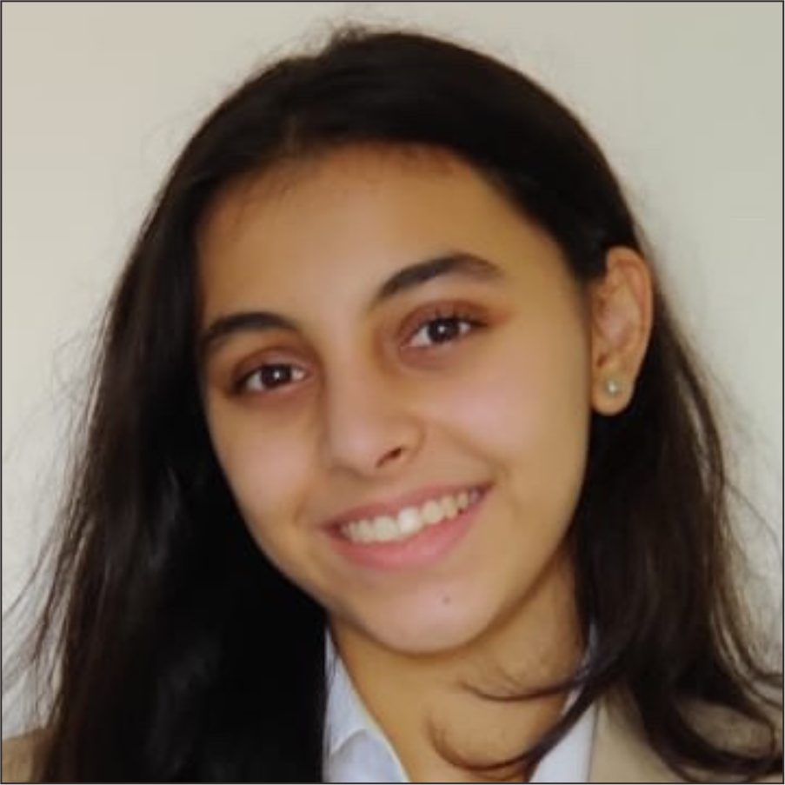
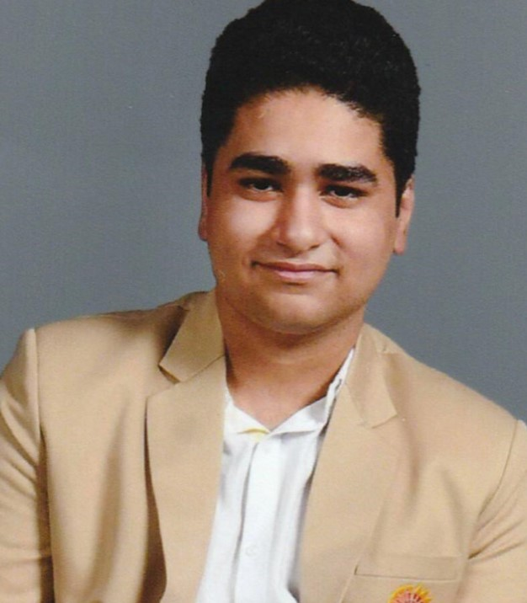
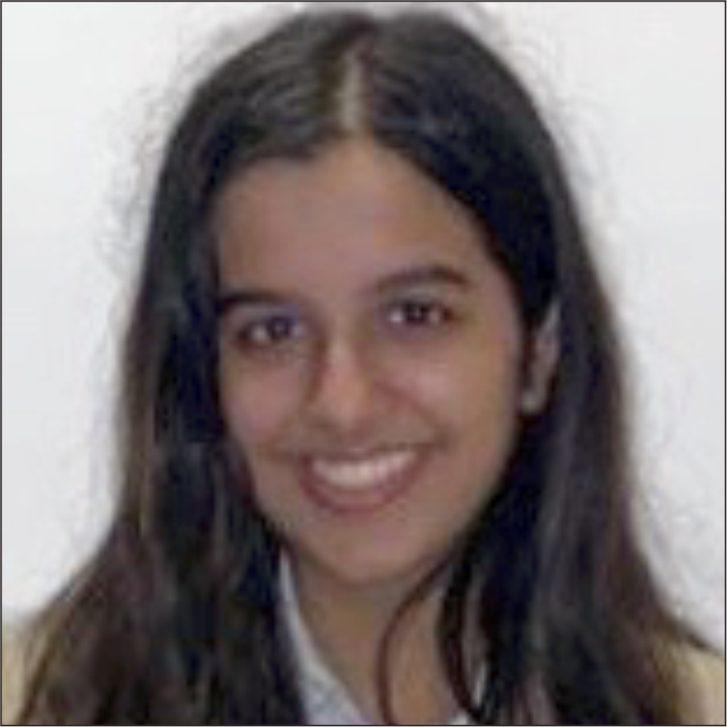
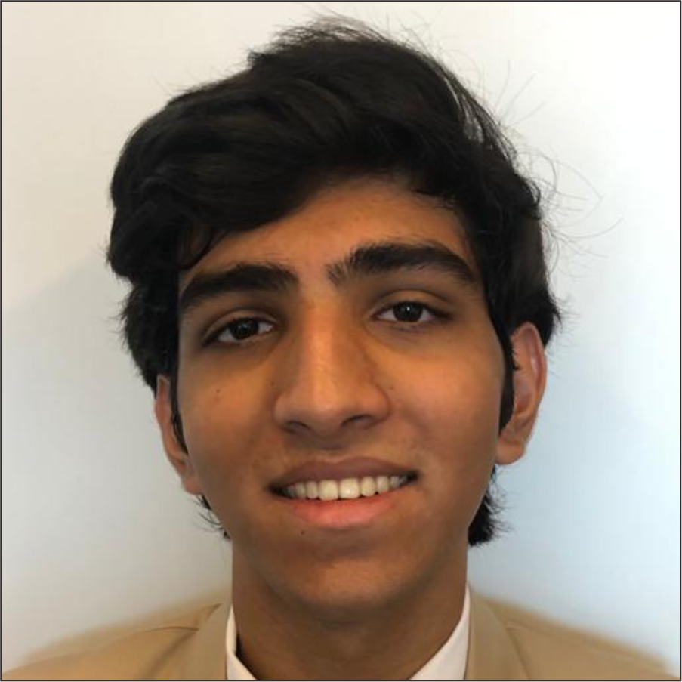
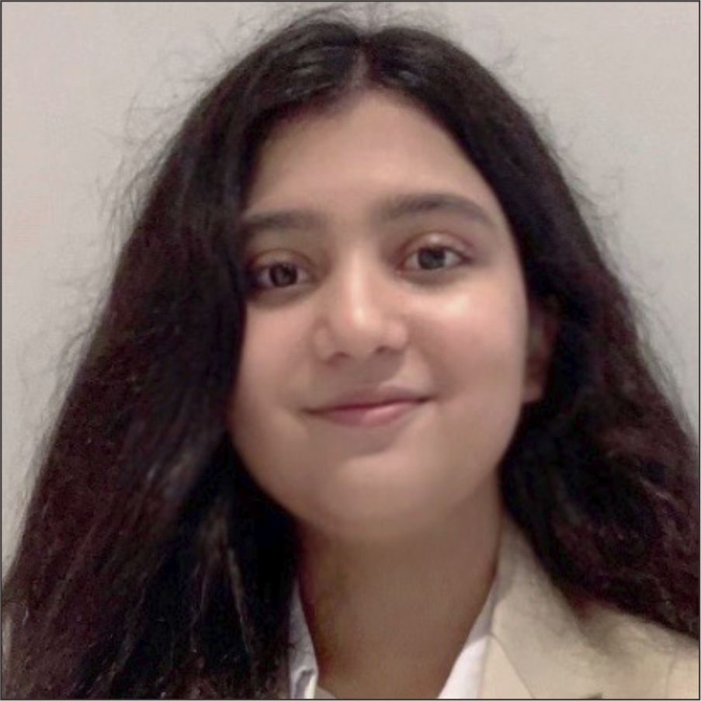
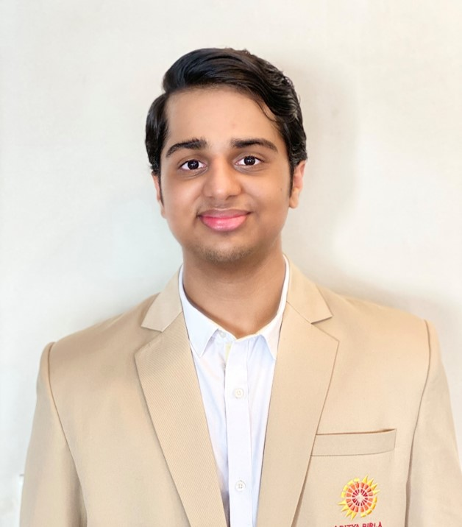
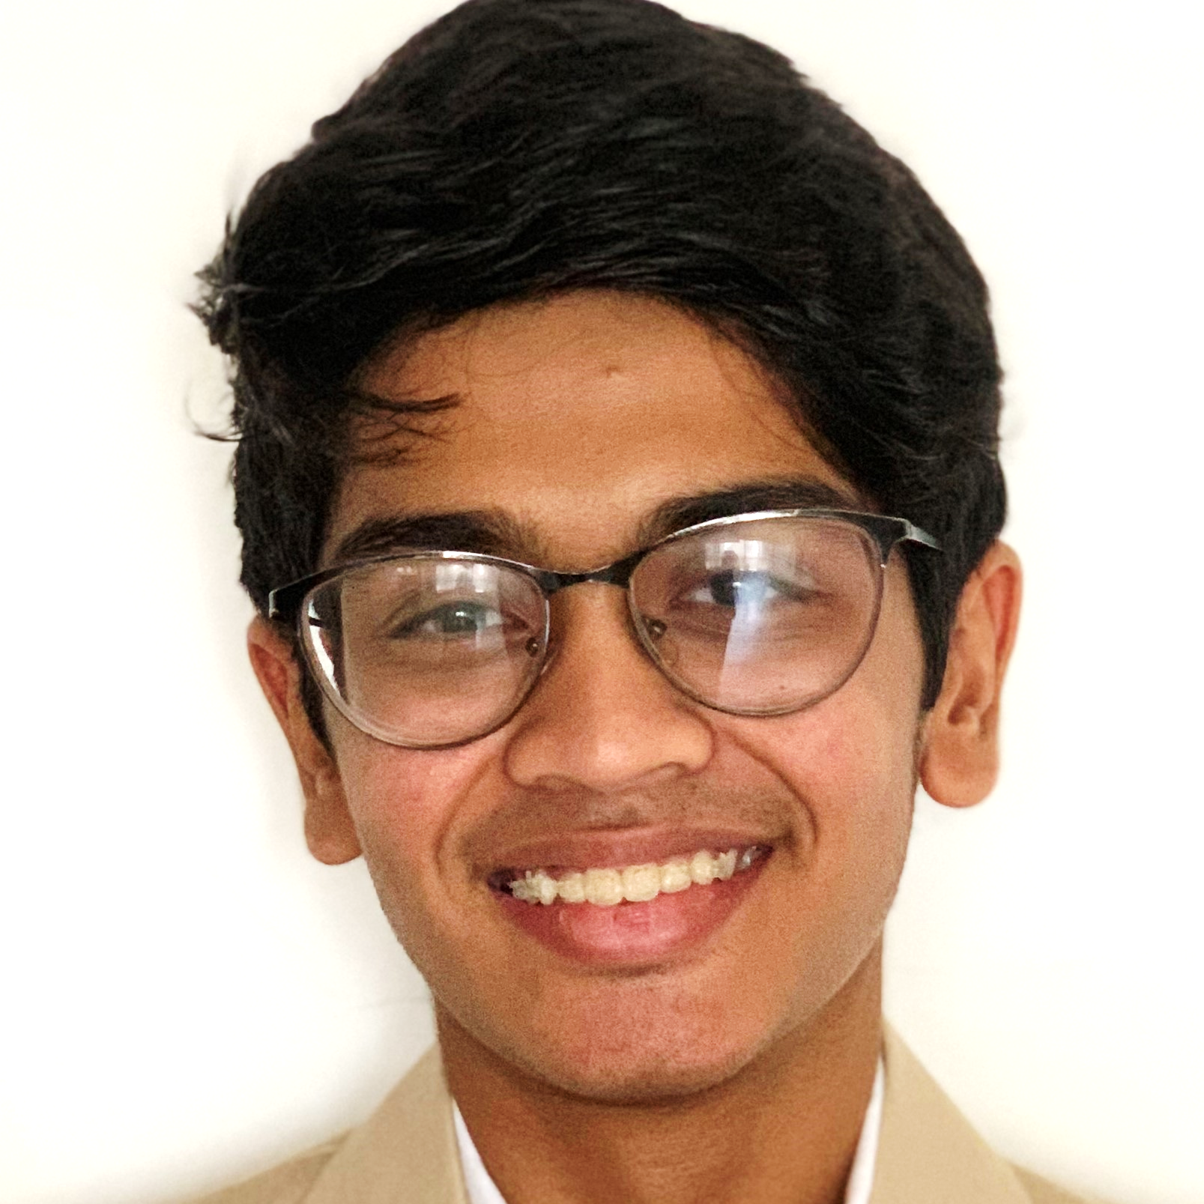
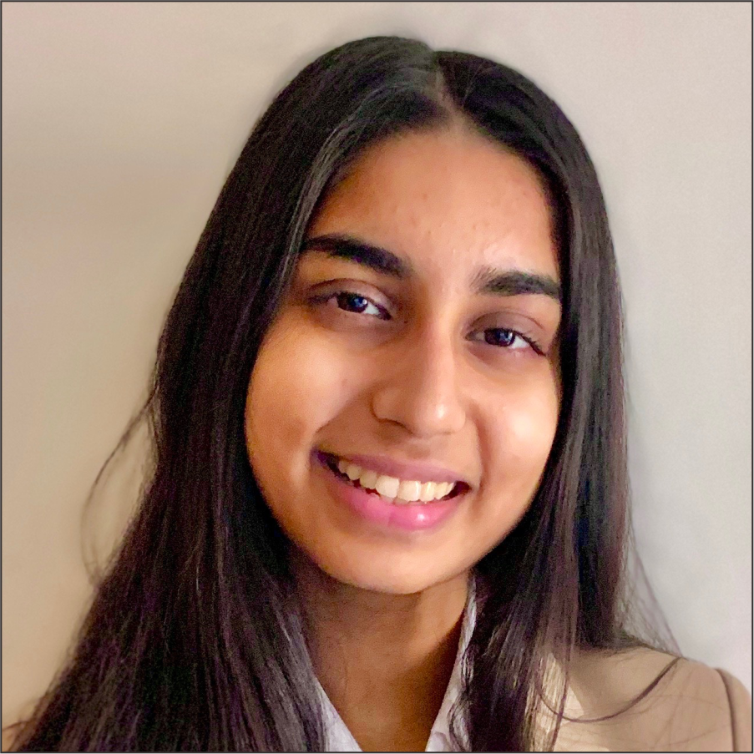
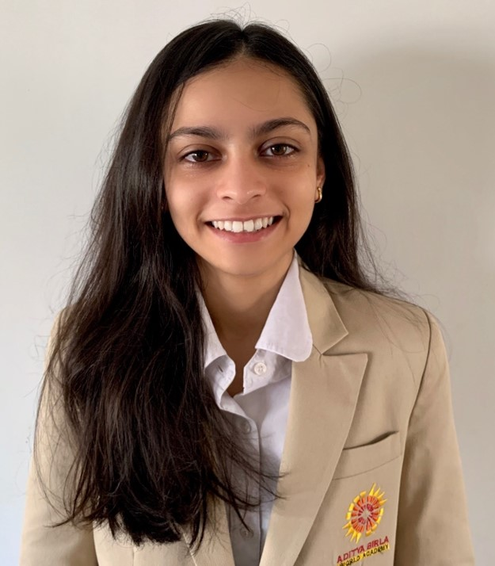
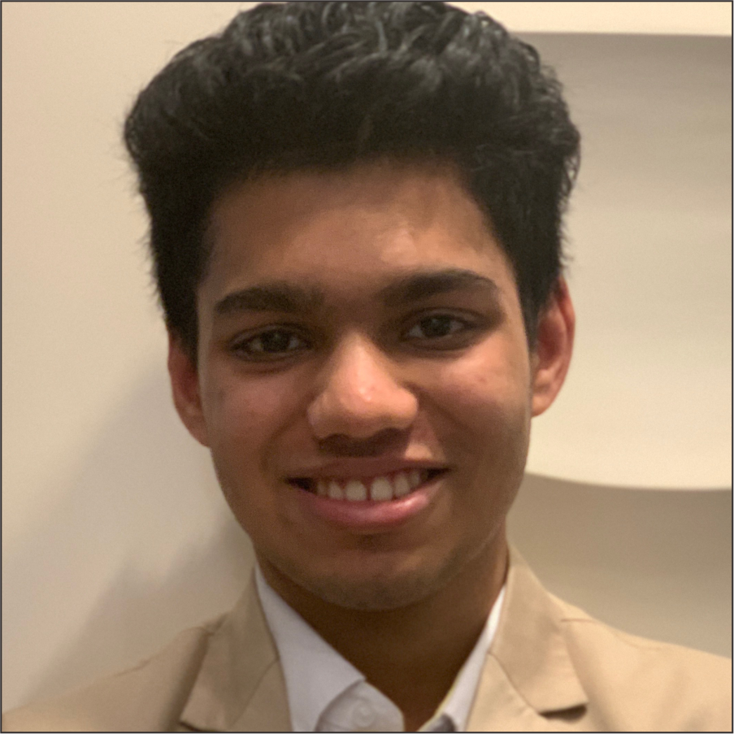
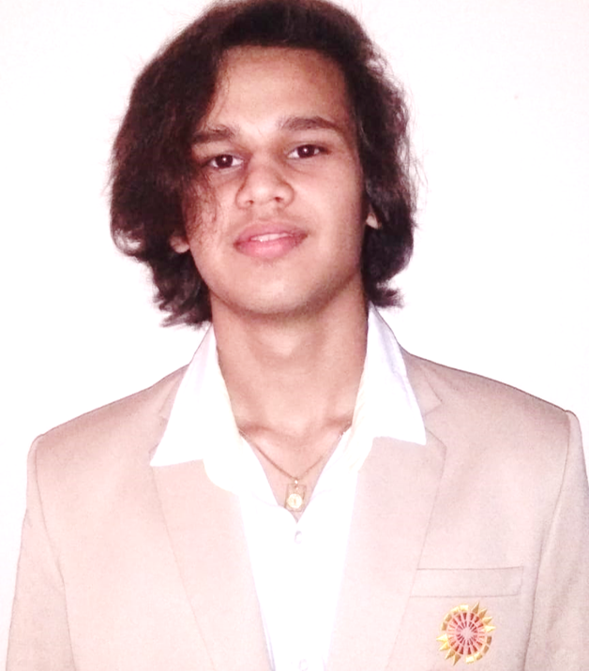
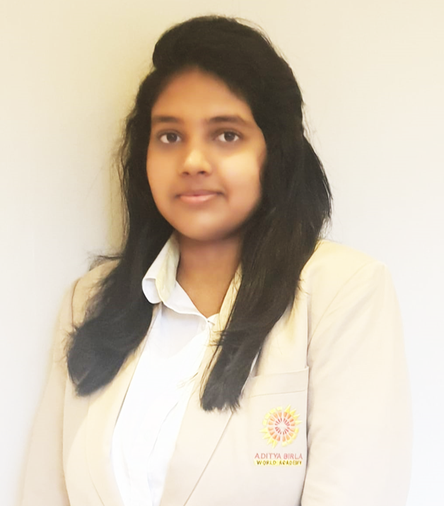
HIGH ACHIEVERS
43
42
42
42
41
41
AASHNA DOSHI
BHAVI KANUGO
NAINIKA SANGHVI
NISHKA MEHTA
AADYA SINGHANIA
ARANYA CHUGANEE
40
41
41
41
40
MOHAMMED GHADIALI
SANA DALAL
VARUN PUNATER
VEDANT GABHAWALA
ANANYA JAIN
40
40
40
40
AADYA PARIKH
KRISH RAMBHIYA
ROHAN SHAH
SANSKRITI AGARWAL

Slide 6

We wish them the best in all their future endeavours!

