Slide 1
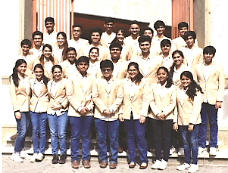
CLASS OF 2018
RESULT ANALYSIS

Slide 2


HIGH ACHIEVERS
Aaryan Pandit-45
Pritka Nayak-43
Anish Samart-42
Hiya Sanghvi-41
Diya Kuwelkar- 41
Devarsi Turahia- 40
Sanika Gupte-40
Varun Suchanti-40
Meet Vaddakachery-40

Slide 3
DP SCORE DISTRIBUTION - 2018
>50% scores are above 35

Slide 4
GRADE DISTRIBUTION - 2018
55% grades are 7’s & 6’s

Slide 5
BONUS POINTS 2018

