Slide 1

HEARTIEST CONGRATULATIONS
TO THE A LEVEL CLASS OF 2017-18!
(Feb/March 2018 Series)

Slide 2
7 students took the A Level Examination (Feb/March 2018 series)
3 students secured grade A* in each of their subjects
6 students secured A* or A in each of their 3 subjects
86% of the grades spread over all subject areas are A* or A
The highest percentage is 94%
3 students have scored 90% or above
The class average is 87%
HIGHLIGHTS

Slide 3
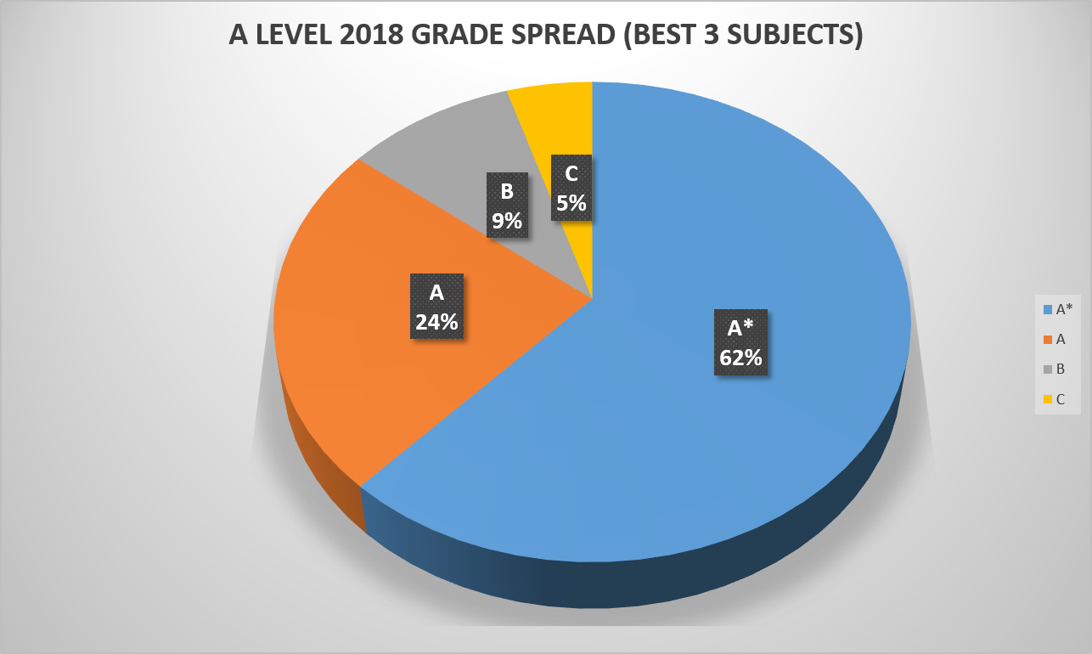
A LEVEL 2018 GRADE SPREAD (BEST 3 SUBJECTS)

Slide 4
SUBJECT HIGHEST
SUBJECT | HIGHEST IN THE SUBJECT
MATHEMATICS | 98
PHYSICS | 92
CHEMISTRY | 93
BIOLOGY | 92
ECONOMICS | 91
BUSINESS | 93
ACCOUNTING | 94
SUBJECT HIGHEST

Slide 5
A LEVEL SUBJECT AVERAGE
A LEVEL SUBJECT AVERAGE

Slide 6
With love to all our students
So go out there and live your dreams
Live the life that you have Imagined!

